Slide 1


Transaction Processing
Asif Sohail
University of the Punjab
Punjab University College of Information Technology (PUCIT)

Slide 2
Transaction Processing
A Transaction is a logical unit of work on the database.
A Transaction may be an entire program, a portion of a program or even a single statement.
A Transaction brings the database from one consistent (correct/acceptable) state to another consistent state.
Consistent state is one in which all data integrity constraints are satisfied.
All transactions are controlled and executed by the DBMS to guarantee database integrity.
While a transaction is in progress, the database may temporarily be in some inconsistent state.

Slide 3
Transaction Processing
Consider the example of a banking transaction involving two relations:
  ACC_TRANS(Acc_No, Amount, Date, Deposit/Withdraw, …)
  ACC_BAL(Acc-No, Balance,…)
Against every insertion in ACC_TRANS, the ACC_BAL must be updated appropriately, otherwise the database will be in some inconsistent or wrong state.

Slide 4
Example Transaction
Register credit sale of 100 units of product X to customer Y for $500
  Reduce product X’s quantity by 100
  Adding $500 to customer Y’s account receivable
UPDATE PRODUCT
SET PROD_QTY = PROD_QTY - 100
WHERE PROD_CODE = ‘X’;
UPDATE ACCT_RECEIVABLE
SET ACCT_BALANCE = ACCT_BALANCE + 500
WHERE ACCT_NUM = ‘Y’;
Notes:
6

Slide 5
Transaction Processing
From the above examples, it is observed that, there can be one of two possible outcomes of a transaction:
  Committed: A Successful completion of a transaction will bring the database into a new consistent state.
  Aborted: An incomplete transaction will leave the database in some inconsistent state.
From 1 & 2, it can be concluded that a transaction must be entirely completed or entirely aborted.
An aborted transaction must be undone or rolled backed to keep the database in some consistent state.
A System component called Transaction Manager or Recovery Manager supports the above feature.

Slide 6
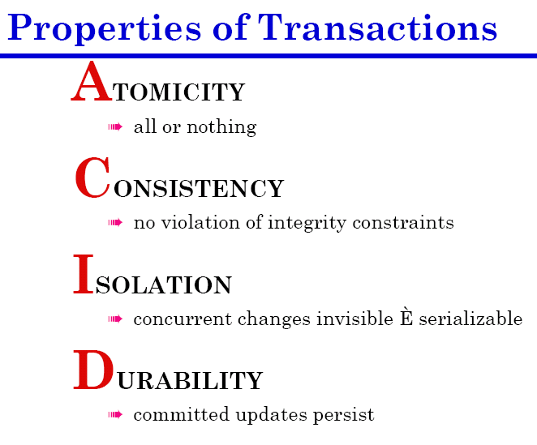

Slide 7
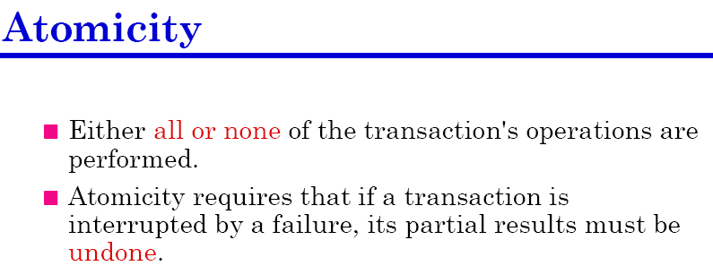
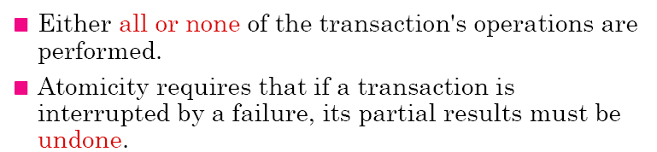

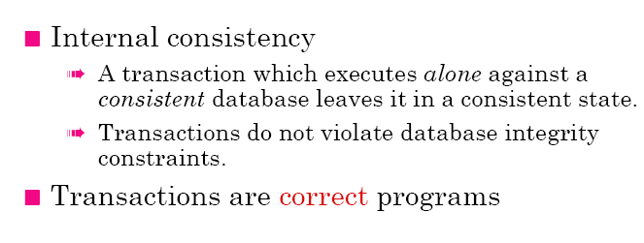
Transaction Properties
Notes:
6

Slide 8
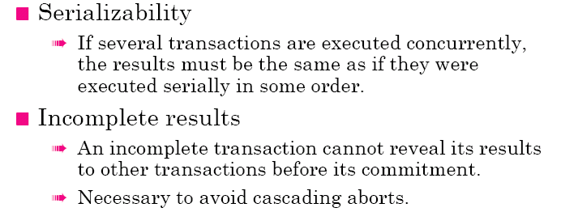
Transaction Properties

Slide 9
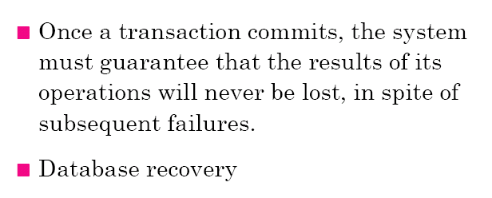
Transaction Properties
Notes:
9

Slide 10
COMMIT, ROLLBACK and SAVEPOINT
Statements for transaction management.
A transaction begins with the first DML statement or by using an explicit SET TRANSACTION statement and ends when a COMMIT or ROLLBACK statement is issued.
Use COMMIT and ROLLBACK SQL statements to terminate a transaction explicitly.
The syntax for COMMIT statement is:
  COMMIT [WORK][COMMENT text];
The optional word WORK is used just to improve readability.
The COMMENT is usually employed by distributed transactions.
  COMMIT COMMENT ‘Employees details have been changed’;
Notes:
Controlling Transactions
You control the logic of transactions with COMMIT and ROLLBACK SQL statements, rendering some groups of database changes permanent while discarding others. As with Oracle Server, DML transactions start at the first command to follow a COMMIT or ROLLBACK and end on the next successful COMMIT or ROLLBACK. These actions may occur within a PL/SQL block or as a result of events in the host environment (for example, ending a SQL*Plus session automatically commits the pending transaction). To mark an intermediate point in the transaction processing, use SAVEPOINT.
Syntax
where: WORK is for compliance with ANSI standards
Note: The transaction control commands are all valid within PL/SQL, although the host environment may place some restriction on their use.
You can also include explicit locking commands (such as LOCK TABLE and SELECT ... FOR UPDATE) in a block (a subsequent lesson will cover more information on the FOR UPDATE command). They stay in effect until the end of the transaction. Also, one PL/SQL block does not necessarily imply one transaction.
COMMIT [WORK];
ROLLBACK [WORK];
SAVEPOINT savepoint_name;
ROLLBACK [WORK] TO [SAVEPOINT] savepoint_name;

Slide 11
COMMIT, ROLLBACK and SAVEPOINT
SVAEPOINT gives more control on transaction management.
SVAEPOINT marks and saves the current point in a transaction.
This allows you to rollback the changes up to that point.
There can be maximum 5 savepoints in a transaction.
The syntax for SAVEPOINT statement is:
  SVAEPOINT savepoint-name;
  SVAEPOINT Emp_savepoint;
Notes:
Controlling Transactions
You control the logic of transactions with COMMIT and ROLLBACK SQL statements, rendering some groups of database changes permanent while discarding others. As with Oracle Server, DML transactions start at the first command to follow a COMMIT or ROLLBACK and end on the next successful COMMIT or ROLLBACK. These actions may occur within a PL/SQL block or as a result of events in the host environment (for example, ending a SQL*Plus session automatically commits the pending transaction). To mark an intermediate point in the transaction processing, use SAVEPOINT.
Syntax
where: WORK is for compliance with ANSI standards
Note: The transaction control commands are all valid within PL/SQL, although the host environment may place some restriction on their use.
You can also include explicit locking commands (such as LOCK TABLE and SELECT ... FOR UPDATE) in a block (a subsequent lesson will cover more information on the FOR UPDATE command). They stay in effect until the end of the transaction. Also, one PL/SQL block does not necessarily imply one transaction.
COMMIT [WORK];
ROLLBACK [WORK];
SAVEPOINT savepoint_name;
ROLLBACK [WORK] TO [SAVEPOINT] savepoint_name;

Slide 12
COMMIT, ROLLBACK and SAVEPOINT
ROLLBACK statement is used to undo the changes made by the transaction. However, it cant undo the changes that have been made permanent by COMMIT statement.
The syntax for ROLLBACK statement is:
  ROLLBACK [WORK][TO savepoint_name];
Examples:
ROLLBACK; // it will undo the changes made by the current transaction (up to the last COMMIT)
ROLLBACK TO rollback_point;
// it will undo the changes up to the specific savepoint.
Notes:
Controlling Transactions
You control the logic of transactions with COMMIT and ROLLBACK SQL statements, rendering some groups of database changes permanent while discarding others. As with Oracle Server, DML transactions start at the first command to follow a COMMIT or ROLLBACK and end on the next successful COMMIT or ROLLBACK. These actions may occur within a PL/SQL block or as a result of events in the host environment (for example, ending a SQL*Plus session automatically commits the pending transaction). To mark an intermediate point in the transaction processing, use SAVEPOINT.
Syntax
where: WORK is for compliance with ANSI standards
Note: The transaction control commands are all valid within PL/SQL, although the host environment may place some restriction on their use.
You can also include explicit locking commands (such as LOCK TABLE and SELECT ... FOR UPDATE) in a block (a subsequent lesson will cover more information on the FOR UPDATE command). They stay in effect until the end of the transaction. Also, one PL/SQL block does not necessarily imply one transaction.
COMMIT [WORK];
ROLLBACK [WORK];
SAVEPOINT savepoint_name;
ROLLBACK [WORK] TO [SAVEPOINT] savepoint_name;

Slide 13
COMMIT, ROLLBACK and SAVEPOINT (Example)
Time
Transaction t1 SAVEPOINT s1;
---------- (a)
---------- (b)
t2 SAVEPOINT s2;
---------- (c)
---------- (d)
t3 SAVEPOINT s3;
---------- (e)
----------(f)
t4 ROLLBACK TO s2;
---------- (g)
---------- (h)
t5 COMMIT; // work done since the start of the transaction plus (g) and (h) will be saved.

Slide 14
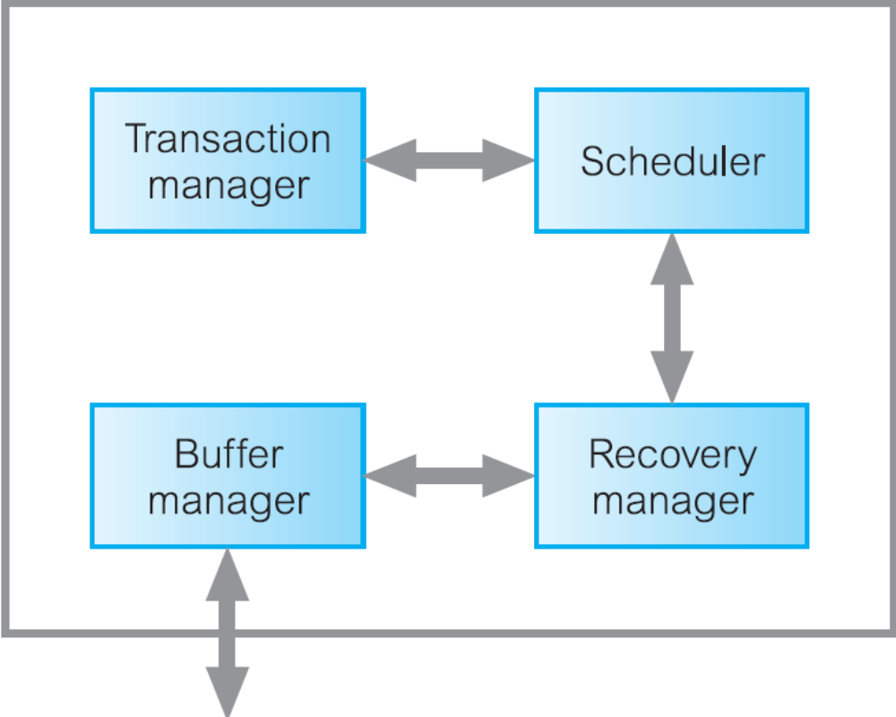
Transaction Management
Database
Notes:
The transaction manager coordinates transactions on behalf of application programs. It communicates with
the scheduler, the module responsible for implementing a particular strategy for concurrency control.
The scheduler is sometimes referred to as the lock manager if the concurrency control protocol is locking-based.
If a failure occurs during the transaction, then the database could be inconsistent.
It is the task of the recovery manager to ensure that the database is restored to the
state it was in before the start of the transaction, and therefore a consistent state.
Finally, the buffer manager is responsible for the efficient transfer of data between
disk storage and main memory.

Slide 15
Buffer Management
An DML operation can be regarded as permanent only after the contents of memory buffer are flushed to secondary storage.
The flushing of the buffers to the database can be triggered by a specific command (COMMIT) or automatically when the buffers become full. The explicit writing of the buffers to secondary storage is known as force-writing.
For efficient buffer management, the following smart measures are used:
  Present / absent bit
  Dirty bit
  Page replacement algorithms

Slide 16
Database Recovery
Database recovery is a process of restoring a database from a given state, usually inconsistent, to some consistent (correct) state in the event of a failure.
The recovery manager of a DBMS is responsible for ensuring two important properties of a transaction: Atomicity and Durability.
It ensures atomicity by undoing the actions of transactions that do not commit and durability by making sure that all actions of committed transactions survive system crashes.
It ensures atomicity by undoing the actions of transactions that do not commit (Roll Backward or Undo)
It ensure durability by making sure that all actions of committed transactions survive even if the system crashes (Roll Forward or Redo).

Slide 17
Database Recovery Facilities
Backup mechanism
Logging facility
Checkpoint facility

Slide 18
Database Recovery Facilities
1. Backup mechanism:
An Automatic dump facility that produces a backup copy of the entire database.
The backup copy is used to restore the database in the event of data loss or damage.
Full Backup
Differential Backup: Only the last modifications to the database (when compared with a previous backup copy).

Slide 19
Database Recovery Facilities
2. Logging facility:
It is also called trail or journal.
It maintains history of actions executed by the DBMS.
Owing to the importance of log, two or more copies of the log on different disks or different locations of the same disk are maintained.
The most recent portion of the log, called log tail is kept in main memory and periodically flushed to stable storage.
Every log record is assigned a unique id called Log Sequence Number (LSN).
A log record is written for each command such as insert, update, delete, undo, commit, savepoint etc.

Slide 20
Database Recovery Facilities
2. Logging facility:
Two types of logs are used for database recovery.
    a) Transaction Log
    b) Database Change Log
Transaction Log stores the information like Transaction Code, Time, Terminal, User, input data values, records accessed and modified.
Database Change Log contains before images and after images of records that have been modified by transactions.
Log Records are written before the transaction is actually committed and it contains both old and updated values.
This is known as Write Ahead Log Protocol.

Slide 21
Database Recovery Facilities
DBMS
Database
(Current)
Transaction
Log
Database
Change Log
Database
(Backup)

Slide 22
Database Recovery Methods
The particular recovery method to be used depends on the extent of the damage that has occurred to the database.
If the database has been extensively damaged, for example a disk head crash has occurred and destroyed the database, then Restore/Rerun technique is used.
If the database has not been physically damaged but has become inconsistent, then either forward recovery or backward recovery is used.

Slide 23
Database Recovery Methods
1. Restore:
The Restore/Rerun technique involves reprocessing the transaction up to the point of failure against the backup copy of the database.
The most recent backup copy of the database is mounted and all transactions(stored on transaction log) that have occurred since the copy are rerun.

Slide 24
Database Recovery Methods
2. Backward Recovery (Roll Backward)
It is also called immediate update recovery protocol.
Updates are applied to the database as they occur without waiting to reach a COMMIT point.
If a transaction fails before it reaches this point, we need to undo the changes.
It is used to undo unwanted changes to the database.
Before images of the records that have been changed are applied to the database.
As a result, the database is returned to an earlier state and the unwanted changes are eliminated.
This is shown in the Fig:

Slide 25
Roll Backward
Database
(With
Changes)
Database
(Without
Changes)
DBMS
Before
Images

Slide 26
Database Recovery Methods
3. Forward Recovery (Roll Forward)
It is also called deferred update recovery protocol.
Updates are deferred and not written to the database immediately until after a transaction has reached its COMMIT point.
If a transaction fails before it reaches this point, it would not have modified the database and so no undoing of changes will be necessary. However, it may be necessary to redo the updates of committed transactions.
It is used to redo the changes that could not be stored to the database because of some failure during a transaction.
After images of the records that could not be changed are applied to the database.
As a result, the database is forwarded to a later state.
This is shown in the Fig:

Slide 27
Roll Forward
Database
(Without
Changes)
Database
(With
Changes)
DBMS
After
Images

Slide 28

Database Recovery
When to use Roll Backward and When to use Roll Forward?
Which Transaction to undo and which to redo?

Slide 29
Checkpointing
A difficulty in recovering from log file is that when a failure occurs we may not know how far back in the log to search.
The DBMS records checkpoints (at certain prescribed intervals) to the log file whenever it writes all of its updated buffers to the disk. Checkpoints are used to synchronize the log file.
A DBMS may perform checkpoints automatically or in response to commands in user application programs.
When failures do occur, the recovery is resumed from the most recent checkpoint.

Slide 30
Undo & Redo
tc tf
Time
T1
T2
T3
T4
T5

Slide 31
Undo & Redo
All transactions T, for which both
<T Starts> and <T Commit> appear in the log are redone.
For transactions S, for which the log contains <S Starts> but not <S Commit> will be undone.
In the Fig above, transactions T3 and T5 must be undone and transactions T2 and T4 must be redone.
At restart, the system goes through the following procedure:

Slide 32
Undo & Redo
It starts with two lists of transactions, the UNDO list and REDO list.
UNDO list is set to all transactions recorded at the time of checkpoint, whereas REDO list is set to empty.
Log is searched starting from the checkpoint record.
If <T Starts> for a transaction T is found in the log, add it to UNDO list.
It <T Commit> for a transaction T is found, move T from UNDO list to REDO list.
When the end of log is reached, the UNDO and REDO lists are identified.

Slide 33
Reasons of Database Failure
System Failure
Database Destruction (Media Failure)
Application software errors
Incorrect data
Natural physical disasters
Sabotage

Slide 34
Reasons of Database Failure
1. System Failure
It affects all transactions currently in progress but does not physically damage the database.
It is also known as soft crash.
Some causes of system failure are power loss, system software failure etc.
System failure can be recovered using Roll Forward and Roll Backward.
2. Database Destruction:
Database itself is lost or destroyed.
It is also known as Hard Crash.
A Backup copy of the database is required for recovery in this situation.

Slide 35
Reasons of Database Failure
3. Application software errors
Logical errors in a program that cause one or more transactions to fail.
4. Incorrect Data
Database updated with an incorrect data may initiate a chain to erroneous transactions leading to database failure.
In such situation, the database can be recovered using:
  Backward Recovery
  Applying a series of compensating transactions to nullify the effect of incorrect input.

Slide 36
Thank you for your attention.
Asif Sohail
Assistant Professor
University of the Punjab
Punjab University College of Information Technology (PUCIT)
Allama Iqbal (Old) Campus, Anarkali
Lahore, Pakistan
Tel: +92-(0)42-111-923-923 Ext. 154
E-mail: asif@pucit.edu.pk

